Slide 1
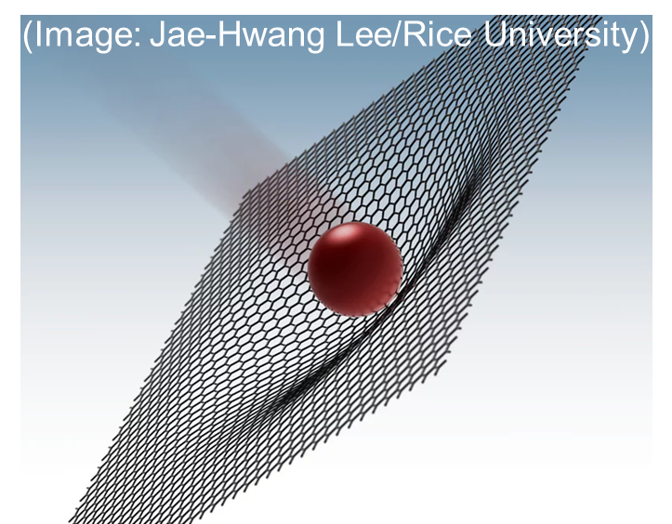
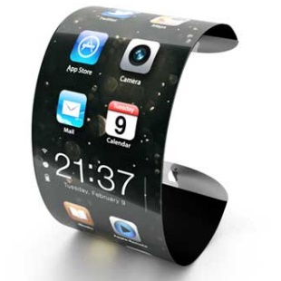
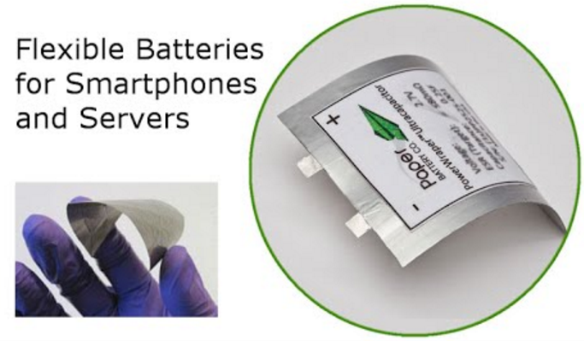
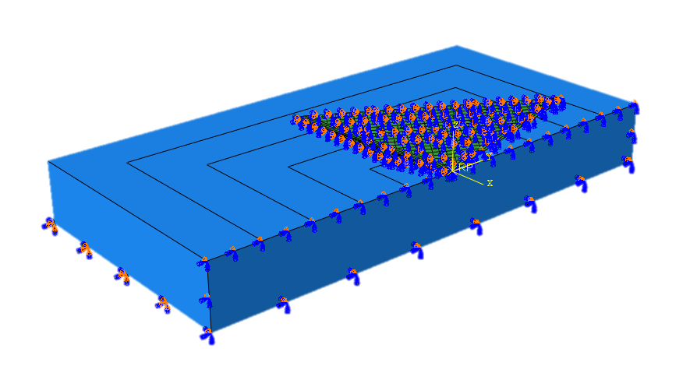
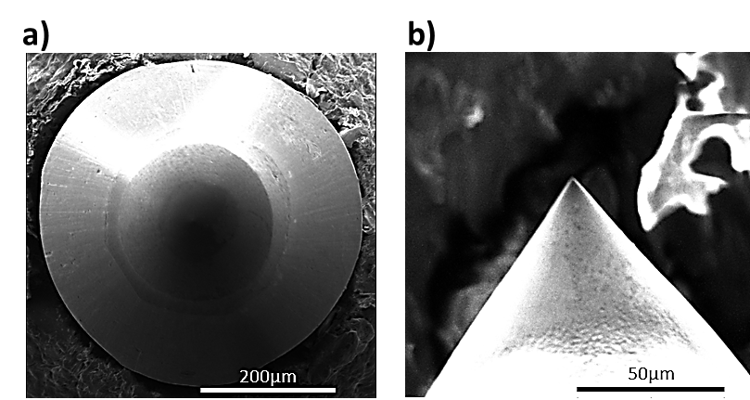
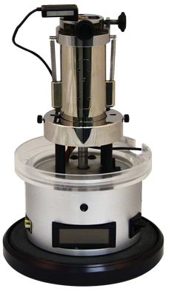
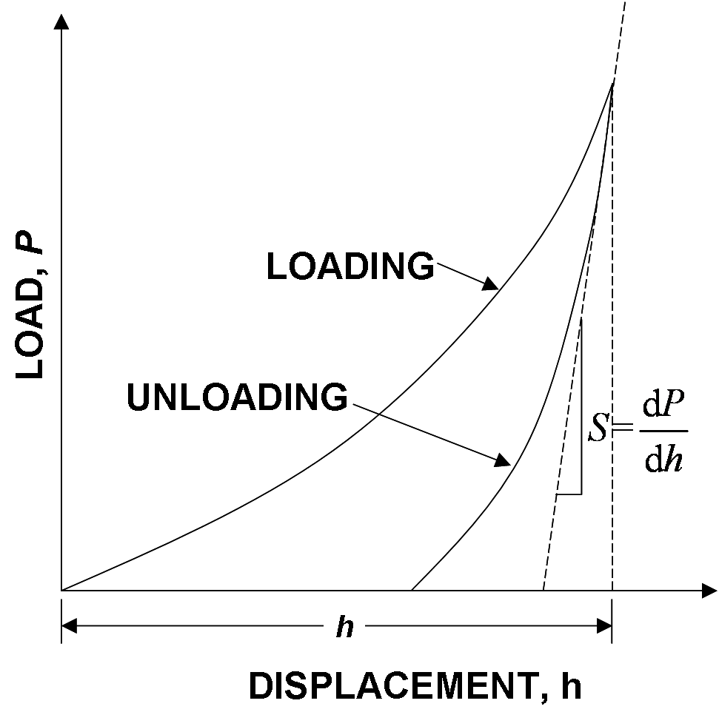
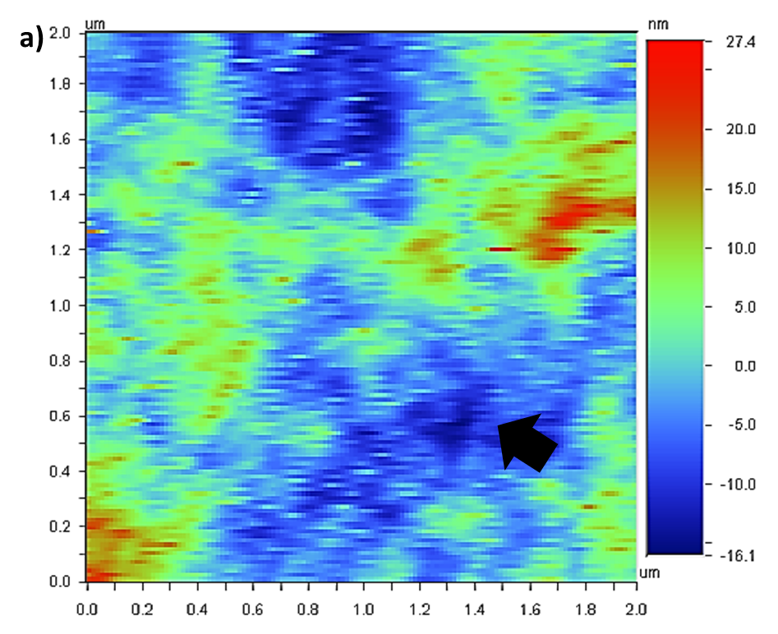
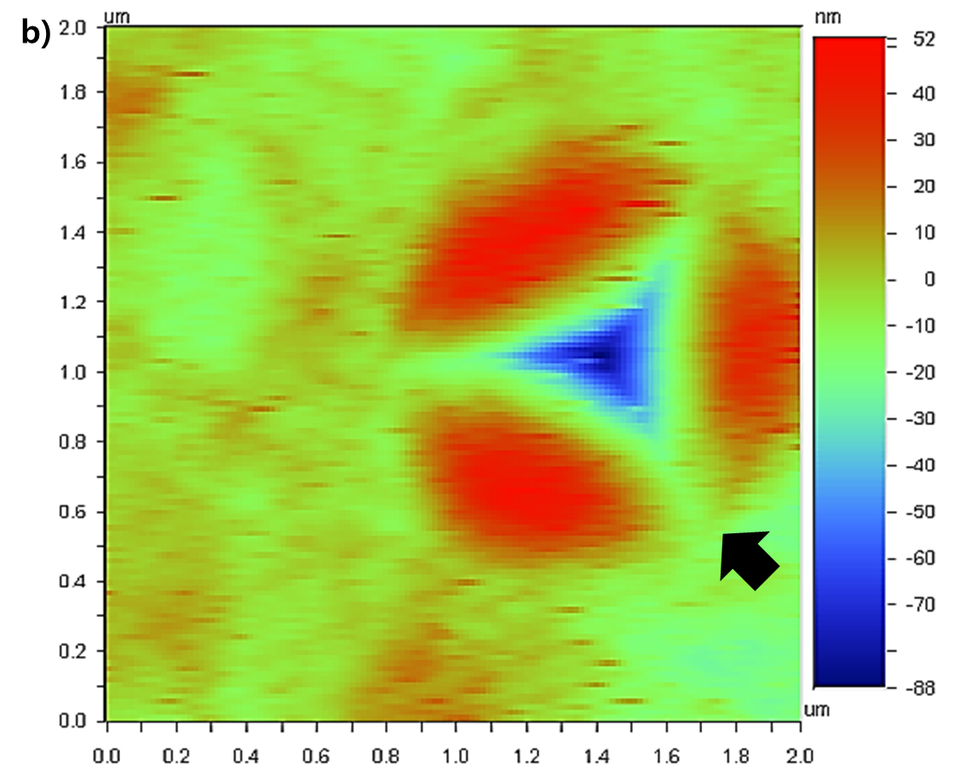



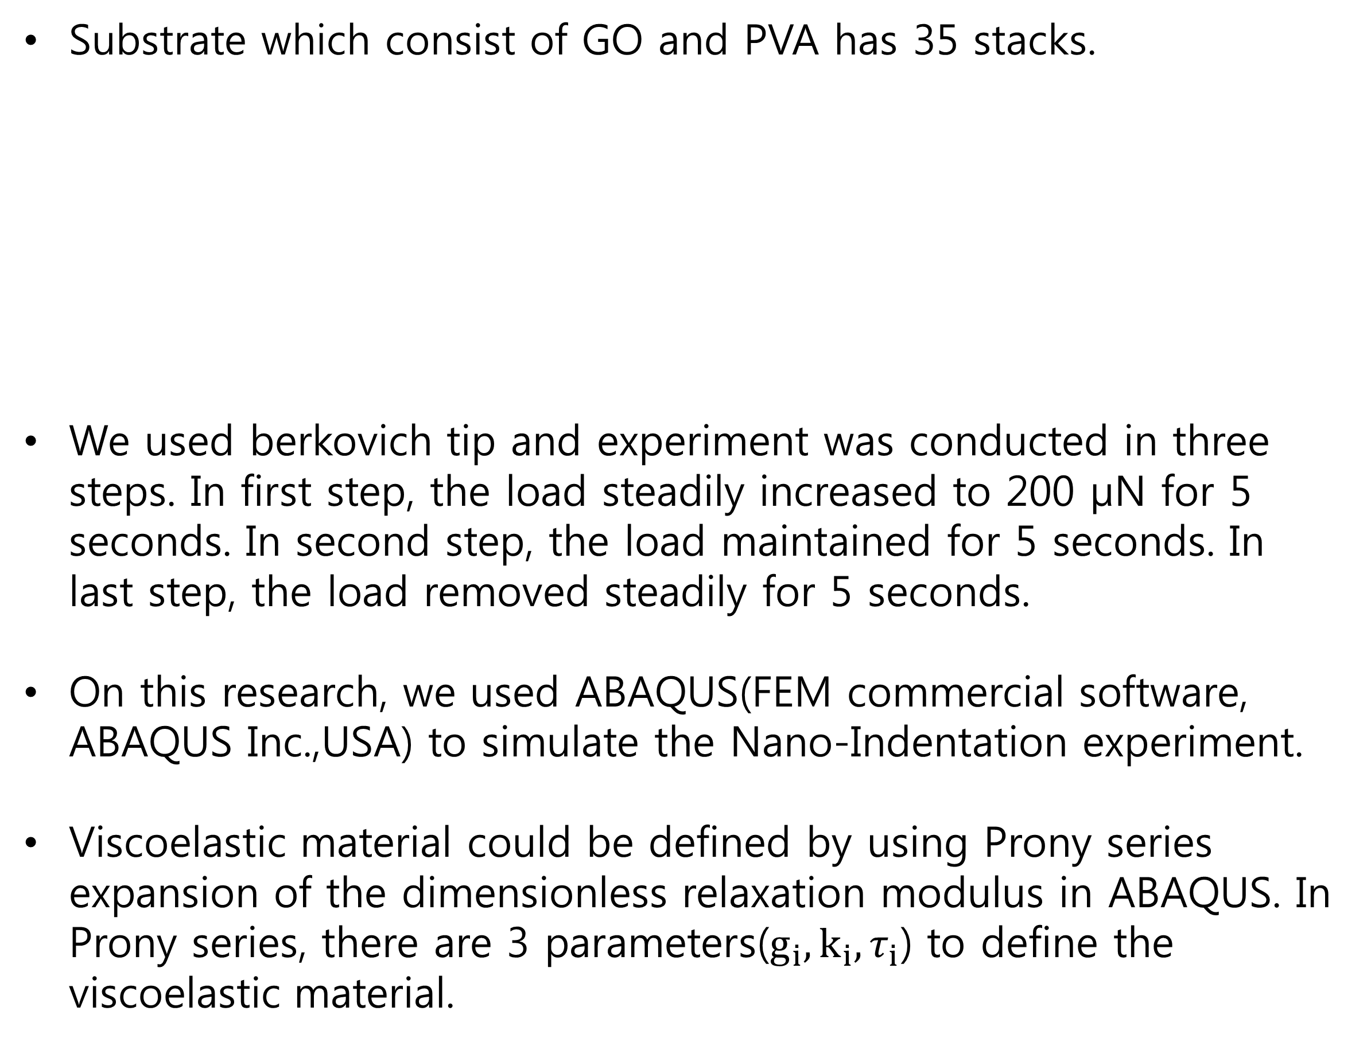
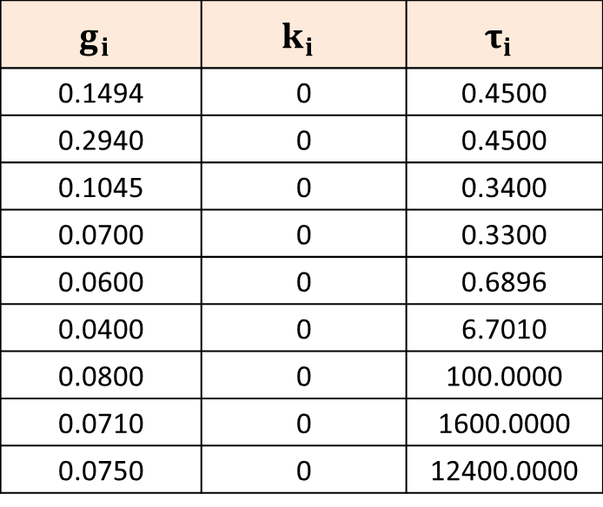
5th International Conference on Materials and Reliability, November 27-29, 2019, Maison Glad Jeju, Jeju, Korea
Mechanical Properties of GO Based Thin Polymer Films: Experiment and Simulation
Hyeonho Cho^{1,†}, JoonHo Lee^{2,†}, jin-Gyun Kim^{2,*}, Sunghan Kim^{1,*}
¹ School of Mechanical Engineering, Chung-Ang University, Seoul, Republic of Korea
² Department of Mechanical Engineering, Kyung Hee University, Yongin, Republic of Korea
† Author Contributions: H. Cho and J. Lee contributed equally to this work. * Correspondence: jingyun.kim@khu.ac.kr; sunghankim@cau.ac.kr
Introduction
Result
FE Model
Compare the GO-PVA experiment with simulation result
Pile ups of GO based PVA films by the indentation
Boundary Condition | Material Property | Load
z
y
concentrated force
Elastic
Viscoelastic
x
 | E (Gpa) | nu
GO | 150 | 0.3
PVA | 5 | 0.45
Various methods are used for fabricating thin polymer films. Among them, the thin polymer films, which are synthesized by LbL method, can be used to provide enhancing mechanical robustness for certain engineering products.
Even though many studies are actively pursued for improving the durability of GO-based LbL films, there is a lack of fundamental knowledge about their mechanical properties.
This present research examines both the hardness and the elastic modulus of graphene GO-based thin polymer films by using Nano-Indentation experiments.
We used FEM method on this research to Verify results of Nano-Indentation experiments.
$$g_{i}$$ | $$k_{i}$$ | $$τ_{i}$$
0.1494 | 0 | 0.4500
0.2940 | 0 | 0.4500
0.1045 | 0 | 0.3400
0.0700 | 0 | 0.3300
0.0600 | 0 | 0.6896
0.0400 | 0 | 6.7010
0.0800 | 0 | 100.0000
0.0710 | 0 | 1600.0000
0.0750 | 0 | 12400.0000
B.C | Substrate | Tip
U1 | V | V
U2 | V | V
U3 | V | -
UR1 | V | V
UR2 | V | V
UR3 | V | V
Experimental Details
Figure 1. a) TriboScope nanoindentation device (TS 75Hysitron, Inc.), b) Schematic diagram of a typical load displacement curve during an indentation experiment, c) Schematic diagram of a typical indented surface during indentaion experiment.
Figure 2. Image of indented surface of reduced GO based PVA films on Si substrate after a) low load indentation experiment under 110 uN and b) high load indentation experiment under 2mN load.
P: applied load, E: elastic modulus, M: indentaion modulus, H: hardness, A: contact area, h: indentation depth, v: poisson’s ratio
The contact area between the tip and the target surface can be significantly increased due to the pile ups.
Material & Method
Discuss
Substrate which consist of GO and PVA has 35 stacks.
We used berkovich tip and experiment was conducted in three steps. In first step, the load steadily increased to 200 μN for 5 seconds. In second step, the load maintained for 5 seconds. In last step, the load removed steadily for 5 seconds.
On this research, we used ABAQUS(FEM commercial software, ABAQUS Inc.,USA) to simulate the Nano-Indentation experiment.
Viscoelastic material could be defined by using Prony series expansion of the dimensionless relaxation modulus in ABAQUS. In Prony series, there are 3 parameters($g_{i},k_{i},τ_{i}$) to define the viscoelastic material.
We used the berkovich tip model as a rigid body because we assumed that there is no deformation on tip.
Young’s modulus and Possion’s ratio of material that make up the composite have a large range of value. So, we used general value of material property.
GO
PVA
. . .
GO
PVA
1 stack
( 7 nm )
1 nm
6 nm
35 stacks
( 245 nm )
1 nm
Conclusion
6 nm
GO-based thin polymer films were fabricated by LbL self-assembly technique.
The mechanical properties, such as the elastic modulus and the hardness of GO based PVA films, were investigated by nanoindentation and FEM analysis. It is found that the mechanical properties of the film structures are mainly affected by interfacial bonding strength.
(1) Vadukumpully, S.; Paul, J.; Mahanta, N.; Valiyaveettil, S., 2011, “Flexible conductive graphene/poly (vinyl chloride) composite thin films with high mechanical strength and thermal stability.”, Carbon, Vol. 49, No.1, pp.198.
(2) Luong, N. D.; Hippi, U.; Korhonen, J. T.; Soininen, A. J.; Ruokolainen, J.; Johansson, L.-S.; Nam, J.-D.; Seppälä, J., 2011, “Enhanced mechanical and electrical properties of polyimide film by graphene sheets via in situ polymerization.”, Polymer, Vol.52, No.23, pp.5237.
(3) Kim, S.; Xiong, R.; Tsukruk, V. V., 2016 “Probing Flexural Properties of Cellulose Nanocrystal–Graphene Nanomembranes with Force Spectroscopy and Bulging Test.”, Langmuir, Vol. 32, No. 21, pp.5383.
(4) Das, B.; Prasad, K. E.; Ramamurty, U.; Rao, C., 2009, “Nano-indentation studies on polymer matrix composites reinforced by few-layer graphene.” Nanotechnology, Vol. 20, No. 12, pp.125705.

